Slide 1
Chapter 14 – Association Rules and Collaborative Filtering
Data Mining for Business Analytics in Python
Shmueli, Bruce, Gedeck & Patel

Slide 2
What are Association Rules?
Study of “what goes with what”
“Customers who bought X also bought Y”
What symptoms go with what diagnosis
Transaction-based or event-based
Also called “market basket analysis” and “affinity analysis”
Originated with study of customer transactions databases to determine associations among items purchased

Slide 3
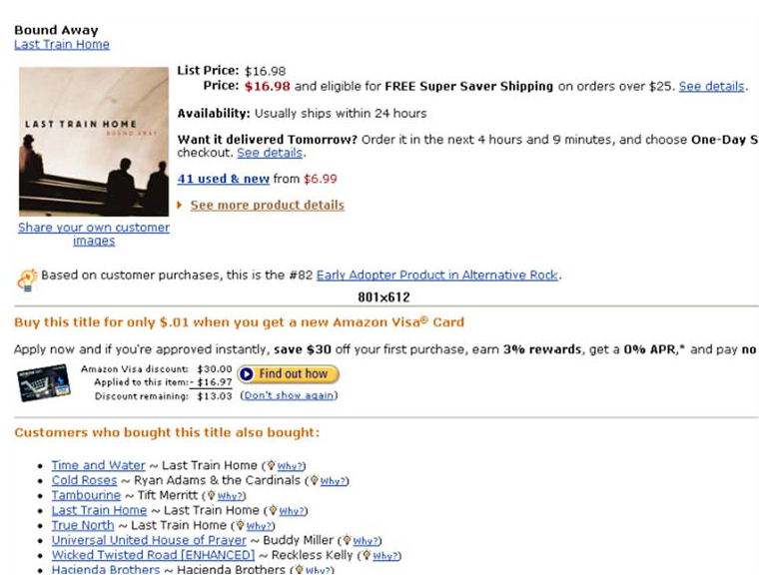
Used in many recommender systems

Slide 4
Import needed functionality
import heapq
from collections import defaultdict
import pandas as pd
import matplotlib.pylab as plt
from mlxtend.frequent_patterns import apriori
from mlxtend.frequent_patterns import association_rules
from surprise import Dataset, Reader, KNNBasic
from surprise.model_selection import train_test_split

Slide 5
Generating Rules

Slide 6
Terms
“IF” part = antecedent
“THEN” part = consequent
“Item set” = the items (e.g., products) comprising the antecedent or consequent
Antecedent and consequent are disjoint (i.e., have no items in common)

Slide 7

Tiny Example: Phone Cases
Transaction Color(s) purchased
1 red white green
2 white orange
3 white blue
4 red white orange
5 red blue
6 white blue
7 red blue
8 red white blue green
9 red white blue
10 yellow

Slide 8
Many Rules are Possible
For example: Transaction 1 supports several rules, such as
“If red, then white” (“If a red faceplate is purchased, then so is a white one”)
“If white, then red”
“If red and white, then green”
+ several more

Slide 9
Frequent Item Sets
Ideally, we want to create all possible combinations of items
Problem: computation time grows exponentially as # items increases
Solution: consider only “frequent item sets”
Criterion for frequent: support

Slide 10
Support
Support for an itemset = # (or percent) of transactions that include an itemset
Example: support for the item set {red, white} is 4 out of 10 transactions, or 40%
Support for a rule = # (or percent) of transactions that include both the antecedent and the consequent

Slide 11
Apriori Algorithm

Slide 12
Generating Frequent Item Sets
For k products…
User sets a minimum support criterion
Next, generate list of one-item sets that meet the support criterion
Use the list of one-item sets to generate list of two-item sets that meet the support criterion
Use list of two-item sets to generate list of three-item sets
Continue up through k-item sets

Slide 13
Measures of Rule Performance
Confidence: the % of antecedent transactions that also have the consequent item set
Benchmark confidence = transactions with consequent as % of all transactions
Lift = confidence/(benchmark confidence)
Lift > 1 indicates a rule that is useful in finding consequent items sets (i.e., more useful than just selecting transactions randomly)
Leverage = P(antecedent AND consequent) - P(antecedent) x P(consequent)
Leverage = 0 when the two items are independent. It ranges from -1 (antecedent and consequent are antagonistic) to +1 (antecedent makes consequent more likely)

Slide 14
Alternate Data Format: Binary Matrix
Transaction Red White Blue Orange Green Yellow
1 1 1 0 0 1 0
2 0 1 0 1 0 0
3 0 1 1 0 0 0
4 1 1 0 1 0 0
5 1 0 1 0 0 0
6 0 1 1 0 0 0
7 1 0 1 0 0 0
8 1 1 1 0 1 0
9 1 1 1 0 0 0
10 0 0 0 0 0 1

Slide 15
Support for an itemset
Transaction Color(s) purchased
1 red white green
2 white orange
3 white blue
4 red white orange
5 red blue
6 white blue
7 red blue
8 red white blue green
9 red white blue
10 yellow
Support for {red, white} = 4

Slide 16
Support for Various Itemsets
{itemset} support (count)
{red} 6
{white} 7
{blue} 6
{orange} 2
{green} 2
{red, white} 4
{red, blue} 4
{red, green} 2
{white, blue} 4
{white, orange} 2
{white, green} 2
{red, white, blue} 2
{red, white, green} 2
Transaction Color(s) purchased
1 red white green
2 white orange
3 white blue
4 red white orange
5 red blue
6 white blue
7 red blue
8 red white blue green
9 red white blue
10 yellow

Slide 17
Process of Rule Selection
Generate all rules that meet specified support & confidence
Find frequent item sets (those with sufficient support – see above)
From these item sets, generate rules with sufficient confidence

Slide 18
Example: Rules from {red, white, green}
{red, white} > {green} with confidence = 2/4 = 50%
[(support {red, white, green})/(support {red, white})]
{red, green} > {white} with confidence = 2/2 = 100%
[(support {red, white, green})/(support {red, green})]
Plus 4 more with confidence of 100%, 33%, 29% & 100%
If confidence criterion is 70%, report only rules 2, 3 and 6

Slide 19
Generating Rules in Python
# Load and preprocess data set
fp_df = pd.read_csv('Faceplate.csv')
fp_df.set_index('Transaction', inplace=True)
print(fp_df)
# create frequent itemsets
itemsets = apriori(fp_df, min_support=0.2, use_colnames=True)
# convert into rules
rules = association_rules(itemsets, metric='confidence', min_threshold=0.5)
rules.sort_values(by=['lift'], ascending=False).head(6)
P(green) if you use the rule
How much better your chances of getting a green are if you use the rule than if you select randomly
antecedents consequents support confidence lift leverage
14 (White, Red) (Green) 0.2 0.5 2.500000 0.12
15 (Green) (White, Red) 0.2 1.0 2.500000 0.12
4 (Green) (Red) 0.2 1.0 1.666667 0.08
12 (Green, White) (Red) 0.2 1.0 1.666667 0.08
7 (Orange) (White) 0.2 1.0 1.428571 0.06
8 ( Green) (White) 0.2 1.0 1.428571 0.06

Slide 20
Interpretation
Lift ratio and leverage show how effective the rule is in finding consequents (useful if finding particular consequents is important)
Confidence shows the rate at which consequents will be found (useful in learning costs of promotion)
Support measures overall impact

Slide 21
Caution: The Role of Chance
Random data can generate apparently interesting association rules. The more rules you produce, the greater this danger.
Rules based on large numbers of records are less subject to this danger.
Rules from some randomly-generated transactions:
Even chance data can produce high lift
antecedents consequents support confidence lift leverage
3 (8, 3) (4) 0.04 1.0 4.545455 0.0312
1 (1, 5) (8) 0.04 1.0 1.851852 0.0184
2 (2, 7) (9) 0.04 1.0 1.851852 0.0184
4 (3, 4) (8) 0.04 1.0 1.851852 0.0184
5 (3, 7) (9) 0.04 1.0 1.851852 0.0184
6 (4, 5) (9) 0.04 1.0 1.851852 0.0184

Slide 22
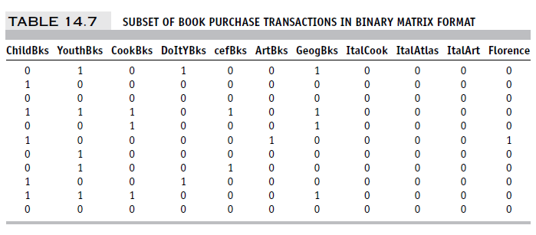
Example: Charles Book Club
Row 1, e.g., is a transaction in which books were bought in the following categories: Youth, Do it Yourself, Geography

Slide 23
Code for running apriori
# load dataset
all_books_df = pd.read_csv('CharlesBookClub.csv')
# create the binary incidence matrix
ignore = ['Seq#', 'ID#', 'Gender', 'M', 'R', 'F', 'FirstPurch',
'Related Purchase', 'Mcode', 'Rcode', 'Fcode', 'Yes_Florence',
'No_Florence']
count_books = all_books_df.drop(columns=ignore)
count_books[count_books > 0] = 1
# create frequent itemsets and rules
itemsets = apriori(count_books, min_support=200/4000, use_colnames=True)
rules = association_rules(itemsets, metric='confidence', min_threshold=0.5)
# Display 25 rules with highest lift
rules.sort_values(by=['lift'], ascending=False).head(25)

Slide 24
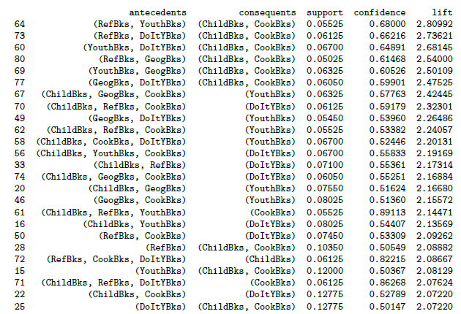
Rules Produced by apriori
Caution:
Duplication (same trio of books)

Slide 25
Summary – Association Rules
Association rules (or affinity analysis, or market basket analysis) produce rules on associations between items from a database of transactions
Widely used in recommender systems
Most popular method is Apriori algorithm
To reduce computation, we consider only “frequent” item sets (=support)
Performance of rules is measured by confidence and lift
Can produce a profusion of rules; review is required to identify useful rules and to reduce redundancy

Slide 26
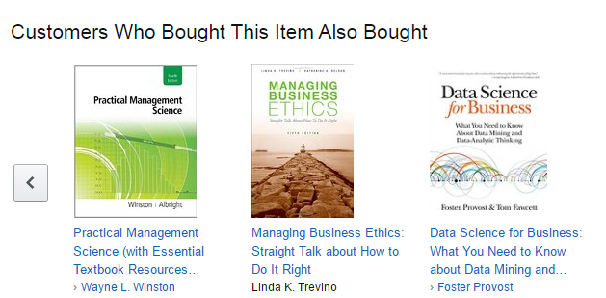
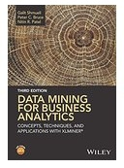
Collaborative Filtering
User based methods
Item based methods

Slide 27
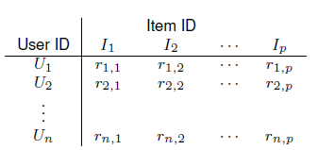
Item-user matrix
Cells are user preferences, r_{ij}, for items
Preferences can be ratings, or binary (buy, click, like)

Slide 28
More efficient to store as rows of triplets
Each row has the user ID, the item ID, and the user’s rating of that item
(U_{u}, I_{i}, r_{ui})

Slide 29
User-based Collaborative Filtering
Start with a single user who will be the target of the recommendations
Find other users who are most similar, based on comparing preference vectors

Slide 30

Measuring similarity
Like nearest-neighbor algorithm
But Euclidean distance does not do well
Correlation proximity does better (Pearson)
For each user pair, find the co-rated items, calculate correlation between the vectors of their ratings for those items
Note that the average ratings for each user are across all products, not just the co-rated ones

Slide 31
Or, … cosine similarity
Like correlation coefficient, except do not subtract the means
“Cold start” problem: For users with just one item, or items with just one neighbor, neither cosine similarity nor correlation produces useful metric
Binary matrix? Must use all the data, not just the co-rated items.
This can add useful info – in the Netflix contest, information about which movies users chose to rate was informative.

Slide 32
Example – Tiny Netflix subset
customer ratings of movies
Movie ID
Customer ID 1 5 8 17 18 28 30 44 48
30878 4 1 3 3 4 5
124105 4
822109 5
823519 3 1 4 4 5
885013 4 5
893988 3 4 4
1248029 3 2 4 3
1503895 4
1842128 4 3
2238063 3
Consider users 30878 and 823519

Slide 33

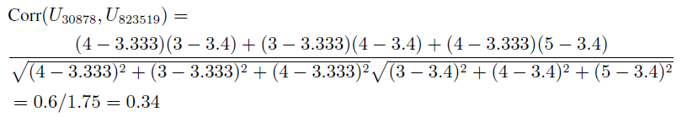
Correlation between users 30878 and 823519
First find average ratings for each user:
Find correlation using departure from avg. ratings for the co-rated movies (movies 1, 28 and 30):

Slide 34
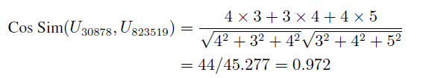
Find cosine similarity for same users
Use raw ratings instead of departures from averages:
Ranges from 0 (no similarity) to 1 (perfect match)

Slide 35
Using the similarity info to make recommendations
Given a new user, identify k-nearest users
Consider all the items they rated/purchased, except for the co-rated ones
Among these other items, what is the best one? “Best” could be
Most purchased
Highest rated
Most rated
That “best” item is the recommendation for the new user

Slide 36
Item-based collaborative filtering
When the number of users is huge, user-based calculations pose an obstacle (similarity measures cannot be calculated until user shows up)
Alternative – when a user purchases an item, focus on similar items
Find co-rated (co-purchased) items (by any user)
Recommend the most popular or most correlated item

Slide 37
Simulate movie rating data similar to Netflix
import random
random.seed(0)
nratings = 5000
randomData = pd.DataFrame({
'itemID': [random.randint(0,99) for _ in range(nratings)],
'userID': [random.randint(0,999) for _ in range(nratings)],
'rating': [random.randint(1,5) for _ in range(nratings)],
})
def get_top_n(predictions, n=10):
# First map the predictions to each user.
byUser = defaultdict(list)
for p in predictions:
byUser[p.uid].append(p)
# For each user, reduce predictions to top-n
for uid, userPredictions in byUser.items():
byUser[uid] = heapq.nlargest(n, userPredictions, key=lambda p: p.est)
return byUser

Slide 38
Collaborative filtering with surprise
# Convert the data set into the format required by the surprise package
# The columns must correspond to user id, item id, and ratings (in that order)
reader = Reader(rating_scale=(1, 5))
data = Dataset.load_from_df(randomData[['userID', 'itemID', 'rating']], reader)
# Split into training and test set
trainset, testset = train_test_split(data, test_size=.25, random_state=1)
## User-based filtering
# compute cosine similarity between users
sim_options = {'name': 'cosine', 'user_based': True}
algo = KNNBasic(sim_options=sim_options)
algo.fit(trainset)
# predict ratings for all pairs (u, i) that are NOT in the training set.
predictions = algo.test(testset)
# Print the recommended items for each user
top_n = get_top_n(predictions, n=4)
print('Top-3 recommended items for each user')
for uid, user_ratings in list(top_n.items())[:5]:
print('User {}'.format(uid))
for prediction in user_ratings:
print(' Item {0.iid} ({0.est:.2f})'.format(prediction), end='')
print()

Slide 39
Partial Output
Top-3 recommended items for each user
User 6
Item 6 (5.00) Item 77 (2.50) Item 60 (1.00)
User 222
Item 77 (3.50) Item 75 (2.78)
User 424
Item 14 (3.50) Item 45 (3.10) Item 54 (2.34)
User 87
Item 27 (3.00) Item 54 (3.00) Item 82 (3.00) Item 32 (1.00)
User 121
Item 98 (3.48) Item 32 (2.83)
Rebuild model using the full dataset
trainset = data.build_full_trainset()
sim_options = {'name': 'cosine', 'user_based': False}
algo = KNNBasic(sim_options=sim_options)
algo.fit(trainset)
# Predict rating for user 383 and item 7
algo.predict(383, 7)
Partial output
Prediction(uid=383, iid=7, r_ui=None, est=2.3661840936304324, ...)

Slide 40
Summary – Collaborative Filtering
User-based – for a new user, find other users who share his/her preferences, recommend the highest-rated item that new user does not have.
User-user correlations cannot be calculated until new user appears on the scene… so it is slow if lots of users
Item-based – for a new user considering an item, find other item that is most similar in terms of user preferences.
Ability to calculate item-item correlations in advance greatly speeds up the algorithm

Slide 41
Association Rules vs. Collaborative Filtering
AR: focus entirely on frequent (popular) item combinations. Data rows are single transactions. Ignores user dimension. Often used in displays (what goes with what).
CF: focus is on user preferences. Data rows are user purchases or ratings over time. Can capture “long tail” of user preferences – useful for recommendations involving unusual items

